Slide 1
Myocardial Infarction
Udit Sethi
2001EE93
Electrical and Electronics Engineering Indian Institute of Technology Patna

Slide 2
Table of contents
01
02
03
04
05
06
07
08
Introduction
Background
Fundamentals
Methodology
Results
Application
Future Aspects
Conclusion

Slide 3
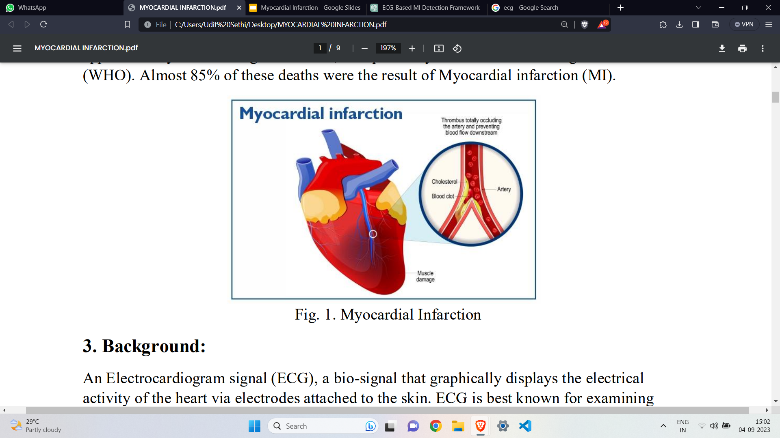
01
INTRODUCTION

Slide 4
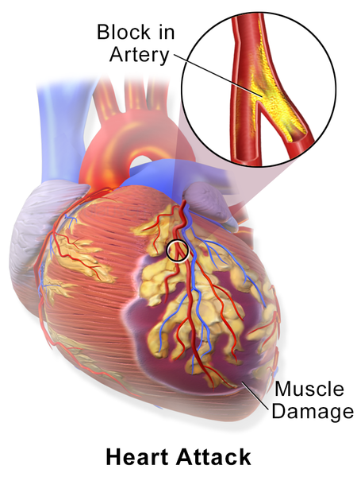
Introduction
Myocardial infarction (MI), commonly known as a heart attack, can cause nonrecoverable impairment to the cardiac muscles, which may even result in fatality.
insufficient oxygen supply to one or more heart muscles leads to myocardial infarction.
therefore, it is crucial to diagnose MI accurately and reliably.
this article proposes a novel framework for detecting MI using a 12-channel Electrocardiogram (ECG) signal.

Slide 5

02
Background

Slide 6
Background
An Electrocardiogram signal (ECG), a bio-signal that graphically displays the electrical activity of the heart via electrodes attached to the skin.
The ECG is recorded as waves and electrical pulses in the heart.
Early detection of MI can lower the risk of a heart attack and, as a result, the risk of irreversible cardiac organ failure.
The primary advantage of deep learning is its ability to learn the most distinctive features from raw data and strive to match its output with the desired outcome.
In one study, an 11-layer convolutional neural network (CNN) is created to automatically distinguish between normal and MI ECG beats (with and without noise) using a single-lead ECG signal.However, the framework has limitations in specific location of a myocardial infarction and is incompatible with a multi-lead ECG.

Slide 7

03
Fundamentals

Slide 8
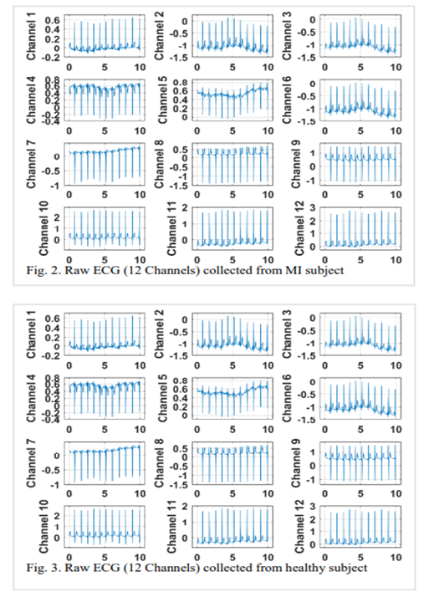
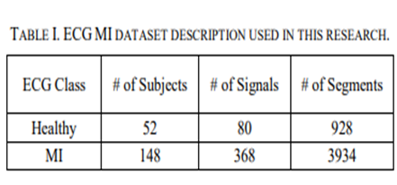
Data Set
This research employs the freely accessible Physiobank PTB-ECG database
which contains recordings of ECG (12-Lead) readings from 52 healthy individuals and 148 patients diagnosed with myocardial infarction (MI).
The ECG data is collected at a sampling rate of 1000 Hz for each lead on a 12-lead ECG. Before processing each ECG data was segmented
Figures 2 and 3 show the raw ECG signal of the MI and healthy subjects obtained through all 12 leads.

Slide 9
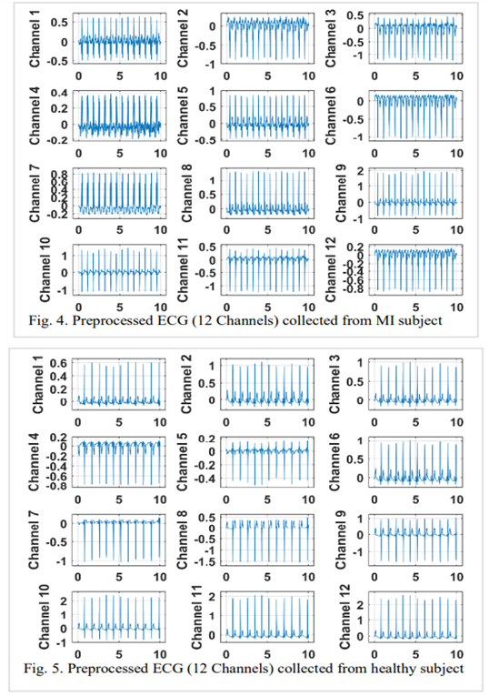
ECG Signal Pre-processing:
Since biomedical signals often get corrupted due to motion artifacts, the high-frequency noise may also contaminate the contents of the original ECG.
Therefore, it's very important to remove baseline wander and high-frequency noise in the data preprocessing step.
Figures 4 and 5 show filtered ECG signals of MI and healthy subjects, respectively.

Slide 10
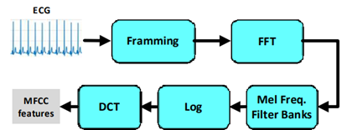
Feature Extraction
The purpose of feature engineering is to determine those numeric parameters from preprocessing data that can best discriminative between multiple classes.
In this research, we extract spectral textures and MFCC features from pre-processed multichannel ECG signals.
1) Spectral Textures: The spectral textures were obtained from all channels of pre-processed ECG signals. The spectral textures were obtained by first transforming the filtered ECG signal to its frequency spectrum through Fast Fourier Transform (FFT).
2) Mel frequency cepstral coefficients (MFCCs): Mel-frequency cepstral coefficients (MFCCs) are one of the most widely used feature extraction methods. The pre-processed ECG signals are split into frames, and these frames are converged into windows while minimizing disruption. Fast Fourier Transform (FFT) is taken for conversion from a time domain to the frequency domain.

Slide 11
04
Methodology

Slide 12
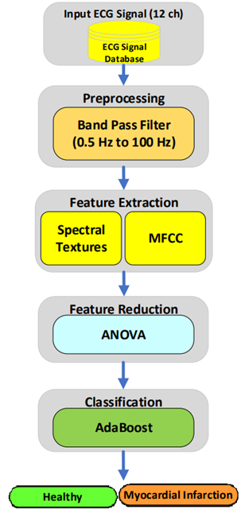
Methodology
Figure shows the proposed framework for the detection of MI using multichannel ECG signals. The proposed method consists of pre-processing, feature extraction, feature selection, and classification steps.
In the first step, a 12- channel ECG signal is passed through a bandpass filter to remove high frequency content and motion artefacts that may deteriorate the overall system's performance.
Next, spectral texture patterns and Mel Frequency Cepstral Coefficients (MFCCs) were extracted and fused to obtain a strong numeric representation of each ECG signal.
We selected the top 20 features ranked through ANOVA and fed them to a range of classification methods. The best performance was achieved using Ad boost ensemble classification.

Slide 13
05
Results

Slide 14
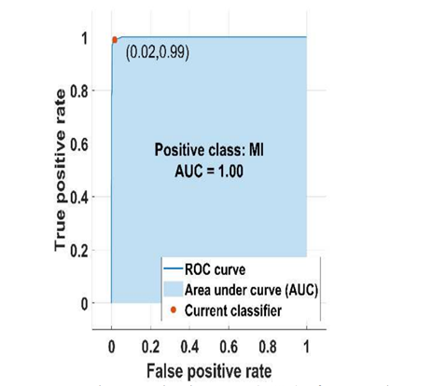
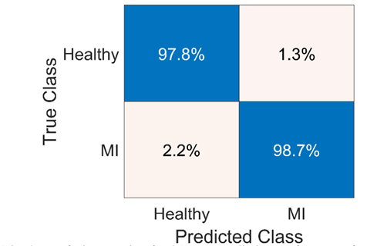
Results
The accuracy, sensitivity, specificity, and error rate are calculated to examine the statistical performance of the classification learners. Here, the healthy class is the negative class whereas the MI class is positive.
First figure illustrates the confusion matrix to demonstrate the overall performance of the proposed methodology.
The highest accuracy was achieved by the AdaBoost classifier with an accuracy of 98.7%, with 99% precision and 98.4% recall. The area under the curve (AUC) for the AdaBoost classifier is shown in second figure.

Slide 15

06
Applications

Slide 16
Applications
The application has significant implications for both clinical practice and biomedical research. Following are the potential applications of this innovative approach:
1. Clinical Diagnosis and Decision Support
2. Telemedicine and Remote Monitoring
3. Emergency Medical Services (EMS)
4. Screening and Risk Assessment
5. Research and Clinical Trials
6. Personalized Medicine
7. Continuous Monitoring and Wearable Devices
8. Education and Training

Slide 17
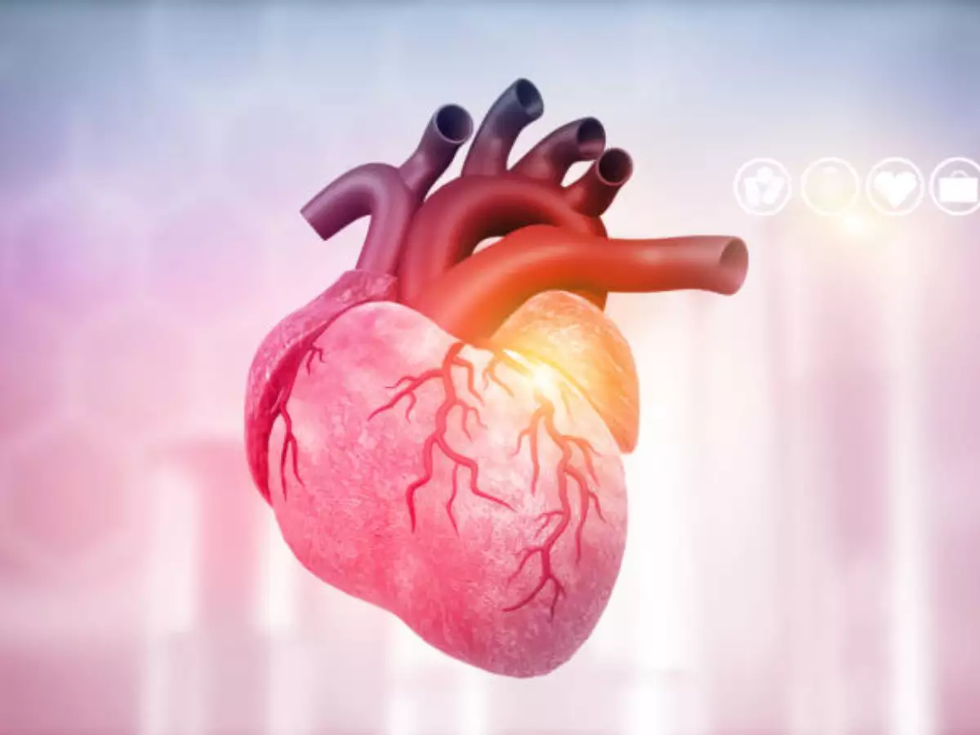
07
Future Aspects

Slide 18
Future Aspects
Future work for MI detection using ECG signals is to explore the use of transfer learning. Transfer learning is a technique that involves leveraging pre-trained models on large datasets to improve the accuracy of models on smaller datasets.
There is a need for the development of user-friendly and accessible tools for MI detection using ECG signals.
Furthermore, the integration of these tools with electronic health record systems can potentially streamline the diagnosis and treatment process for patients with MI.
Overall, there is a lot of potential for the use of machine/deep learning in MI detection using ECG signals, and further research in this field can potentially improve the accuracy of diagnosis and treatment for patients with MI.

Slide 19
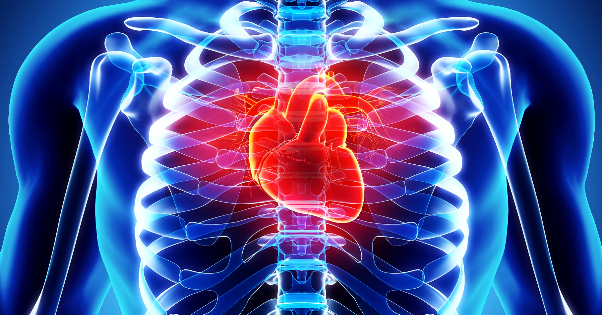
08
Conclusion

Slide 20
Conclusion
This research has illustrated that causes of myocardial infarction can accurately be detected using twelve-channel ECG signals.
Features were extracted using novel spectral textures (1x20) and MFCC features (1x4). Hence, we got (12x24=288) features. Feature dimension was reduced using the ANOVA feature reduction method.
Then, the final feature vector was given to multiple state-of-the-art classifiers like Support Vector Machine (SVM), K-Nearest Neighbour, AdaBoost ensemble method, etc.
Significant performance was shown by AdaBoost with a classification accuracy of 98.7%. The proposed framework has the potential to be adapted for clinical diagnosis.

Slide 21
Thanks

